Slide 1
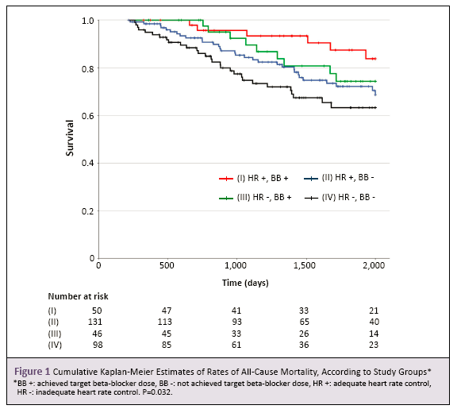
Please use font Arial, size 80, for the abstract title.
Please use font Arial, size 50, for the names and countries/affiliations of all authors.
Please use font Arial, size 50, for the names and countries/affiliations of all authors
Purpose
Please use font Arial, size 50, for the content.
Example Example Example Example Example Example Example Example Example Example Example Example Example Example Example Example Example Example Example Example Example Example Example Example Example Example Example Example Example Example Example Example Example Example
Methods
Example Example Example Example Example Example Example Example Example Example Example Example Example Example Example Example Example Example Example Example Example Example Example Example Example Example Example Example Example Example Example Example Example Example Example Example Example Example Example Example
Results
Example Example Example Example Example Example Example Example Example Example Example Example Example Example Example Example Example Example Example Example Example Example Example Example Example Example Example Example Example Example Example Example Example Example Example Example Example Example Example Example
Conclusions
Example Example Example Example Example Example Example Example Example Example Example Example Example Example Example Example Example Example Example Example Example Example Example Example Example Example Example Example Example Example Example Example Example Example Example Example Example Example Example Example
QR Code

